Slide 1
Title: Impact of COVID-19 Deaths on Stock Market
Drive Link
https://drive.google.com/drive/folders/1L9WKun7X6ojoGvx7F-5_RamziUVVAuhu?usp=sharing
Team Members
Yuva Raj Jami -11690083 Gaddam Durgasantosh -11722484
Chavalam Venkata Chennaiah -11733972
Chilukuri Tagore Reddy -11652327

Slide 2
Goals and Objectives
Motivation​:
The COVID-19 pandemic, which emerged in late 2019, has had a profound and lasting impact on the global economy.
Stock markets around the world experienced significant fluctuations in response to the pandemic's developments, raising questions about the relationship between public health crises and financial markets.
This project seeks to explore and quantify the influence of COVID-19 deaths on the S&P 500 stock prices.
Significance:
Understanding the dynamic relationship between pandemics and financial markets is of paramount importance for investors, policymakers, and researchers.
This research aims to provide insights into how public health crises, such as COVID-19, affect economic systems and, in particular stock market behavior.
Using machine learning to explore and measure the impact of the COVID-19 pandemic on the S&P 500 stock prices.
Even though there were numerous machine learning models available to predict the stock market volatility.
This can lead to more accurate risk assessments and potentially reduce the impact of such unforeseen events in future scenarios.

Slide 3
Goals and Objectives
Objectives​:
To investigate the impact of COVID-19 deaths on the S&P 500 stock prices.
To develop a machine learning model that can predict stock market movements based on COVID-19 data.
To analyze and visualize trends and correlations between COVID-19 deaths and stock market performance.
To contribute valuable knowledge to the fields of finance, epidemiology, and data science.
Features:
Comprehensive data collection from reliable sources.
Rigorous data preprocessing and alignment techniques.
Exploratory data analysis to uncover patterns and insights.
Machine learning model development for stock market prediction.
Integration of findings from relevant research papers.

Slide 4
Background Task
Exploratory data analysis:
To identify the relationships, trends, and patterns within a dataset, exploratory data analysis, or EDA, is a crucial initial phase in data analysis. It includes collecting, organizing, and visualizing data.
To get insights and develop further analytical plans, it uses feature analysis, hypothesis testing, descriptive statistics, and data visualization methods.
https://ieeexplore.ieee.org/document/10020611
Model Development
Model development is one of the important task when as it defines features and the target variables. Training a dataset to perform a Linear Regression to evaluate metrics such Mean Squared Error (MSE), Root Mean Squared Error (RMSE), and R-squared (R2).
Additionally, 5-fold cross-validation is performed to assess model robustness. This approach enables predictive modeling model's performance and generalization capabilities.
To simplify and connect the application of these technologies with higher-level objectives for growth, we developed a goal-oriented approach.
https://ieeexplore.ieee.org/document/9643820

Slide 5
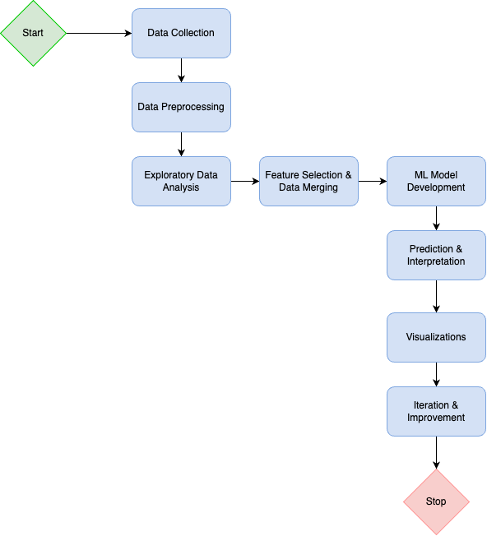
Architectural Flow Diagram
For Prediction Model

Slide 6
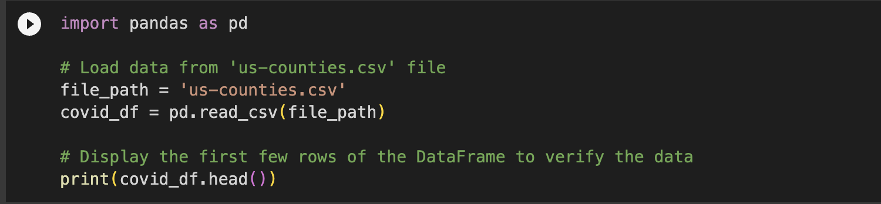
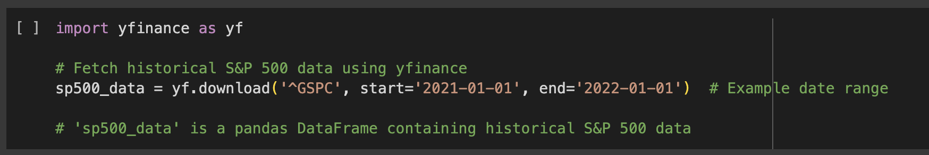
Data Collection | COVID-19
By collecting COVID-19 data related to US-counties from Kaggle we have collected the data frame from a CSV file.
Historical S&P 500 data can be obtained from January 1, 2021, to January 1, 2022, using the dedicated package, and it was saved inside the Pandas data frame.
The data sets Covid-19 and S&P 500 Data are ready to be processed or analyzed further in the Python environment.
COVID-19:
S&P 500

Slide 7
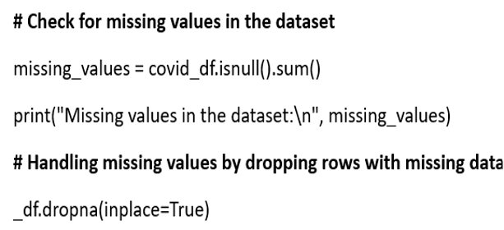
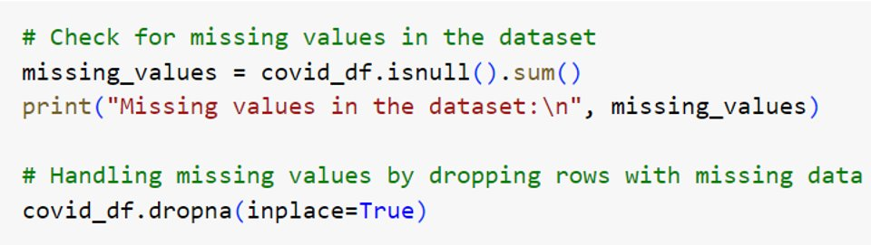
Data Preprocessing | COVID-19
By analyzing possible relationships between the S&P 500 Close Price and COVID-19 instances, performing data analysis on the financial and health trends of the S&P 500 over time, and updating historical S&P 500 data. It determines the link between spreading and financial metrics, using Matplotlib to show stock patterns and to retrieve updated S&P 500 data.
COVID-19: Missing Data
Pseudo Code:
Source Code:

Slide 8
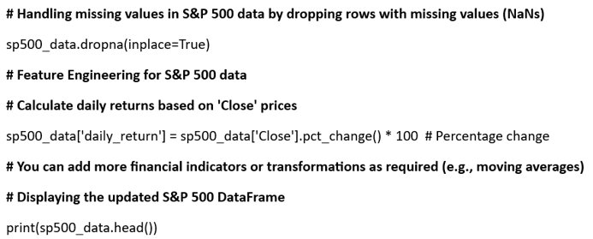
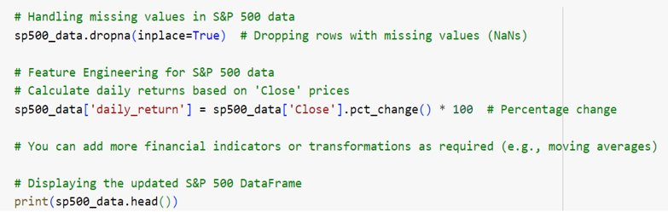
Data Preprocessing | S&P 500
This complete approach offers insights into possible relationships between financial indices and health-related variables, which are essential for decision-making and further exploratory data analysis. It additionally helps to understand market behavior when it comes to medical emergencies. For accurate correlations, modifications depending on the actual data column names and range adjustments could be required.
S&P 500: Missing Data
Pseudo Code:
Source Code:

Slide 9
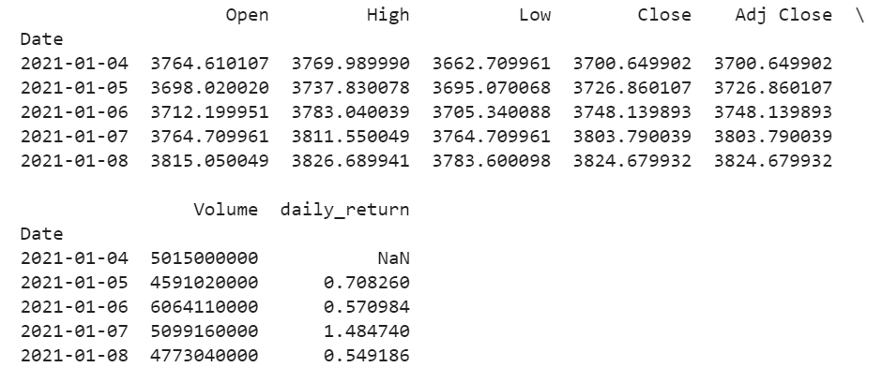
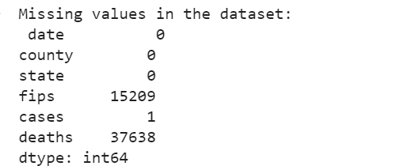
Data Preprocessing | Outputs
Following is an output for collected data from Covid-19 and S&P 500 data after preprocessing.
We have removed NaN or null values and Dropped columns related to them for better data analysis.
Output for COVID-19:
Output for S&P 500:

Slide 10
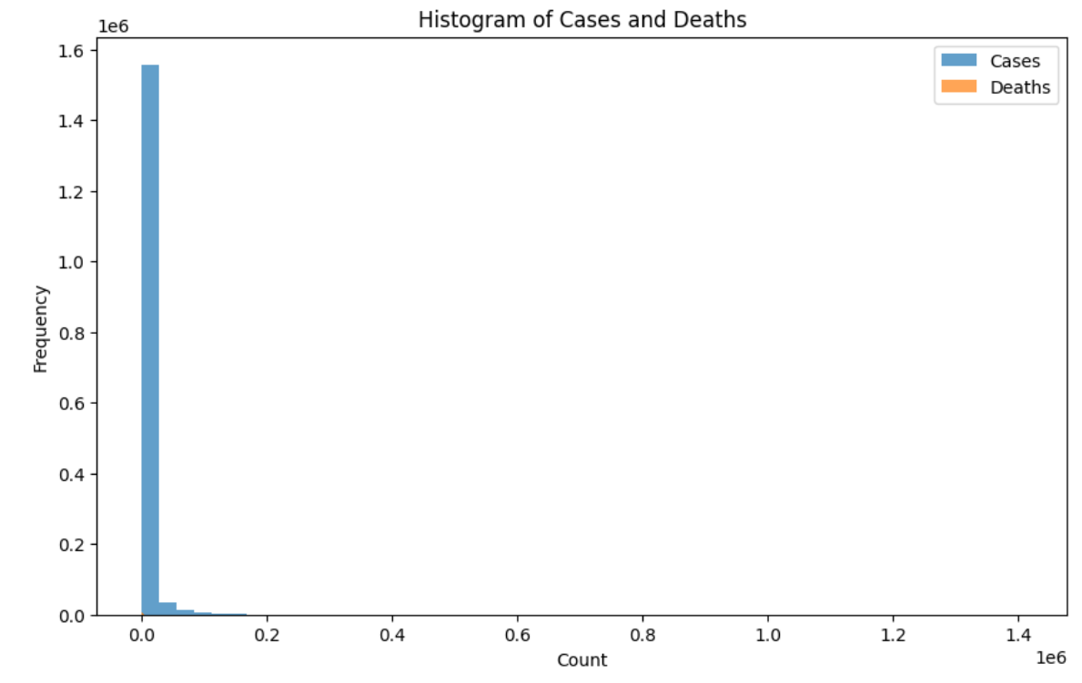
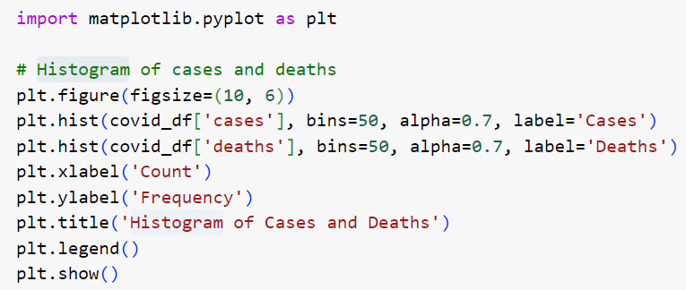
Exploratory data analysis or EDA | Histogram
By analyzing possible relationships between the S&P 500 Close Price and COVID-19 instances, running data analysis on the financial and health trends of the S&P 500 over time, and updating historical S&P 500 data. It calculates the link between growing and financial metrics.
This complete approach offers insights into possible relationships between financial indices and health-related variables, which are important for decision-making and further exploratory data analysis.
Histogram:
Source Code:
Output:

Slide 11
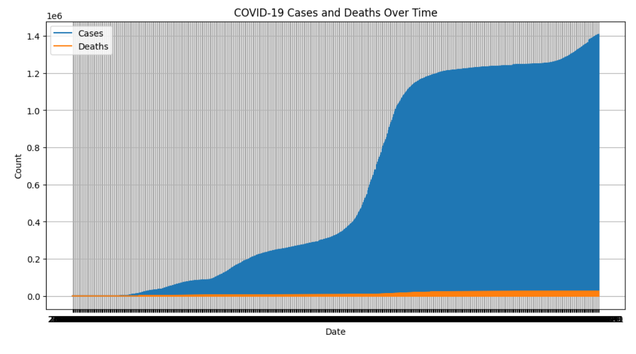
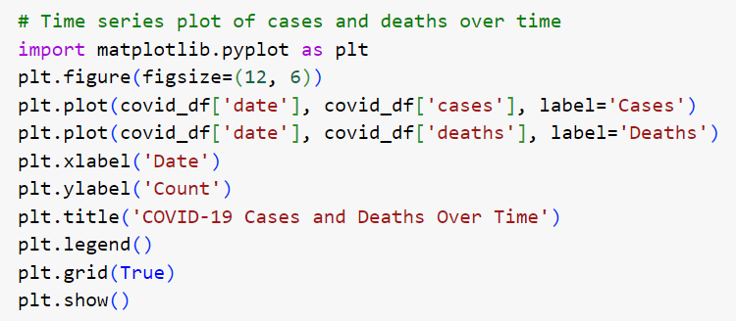
Exploratory data analysis or EDA | Time series
Following is an output for collected data from Covid-19 and S&P 500 data for specific timeline from 2020 - 2021.
This Time series plot shows the cases and deaths that occurred at US-Counties during that period of time.
Time series:
Source Code:
Output:

Slide 12
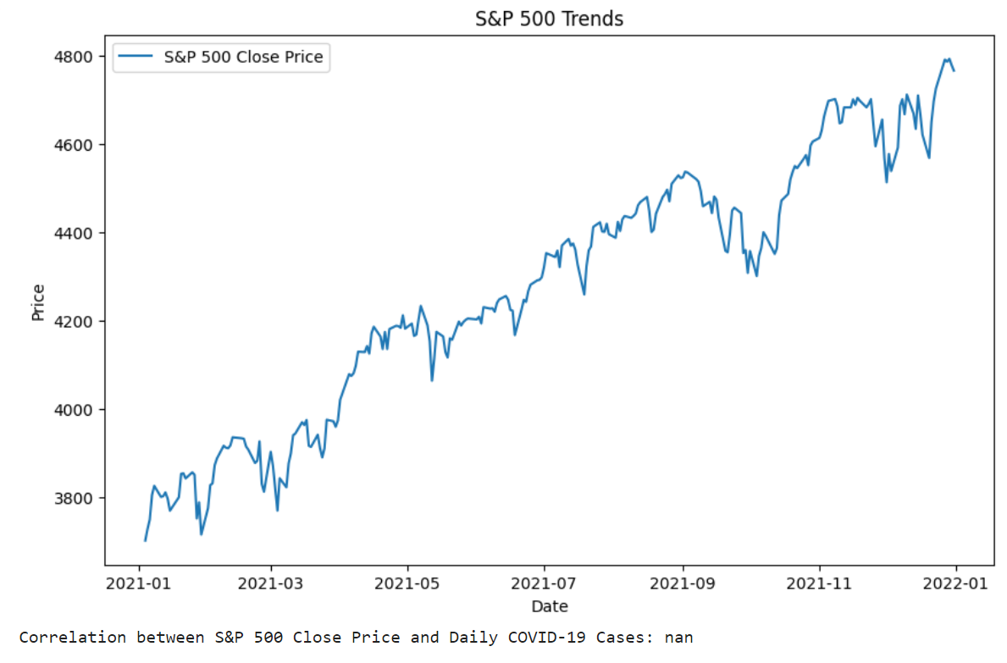
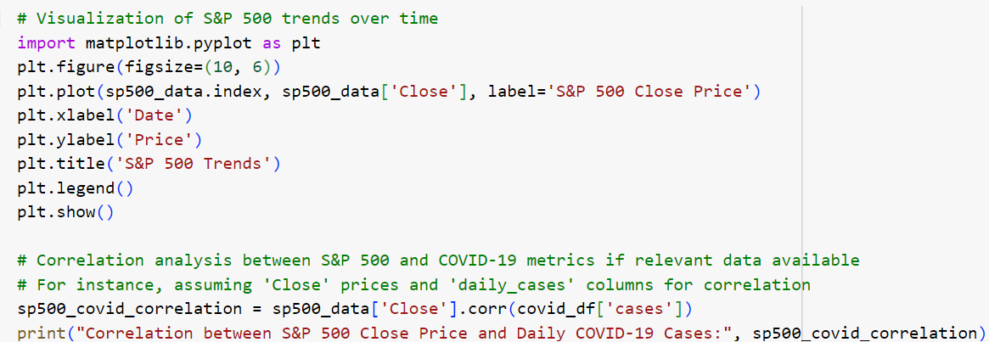
Exploratory data analysis or EDA | S&P 500
Following is an output for collected data from Covid-19 and S&P 500 data.
Visualization:
Source Code:
Output:

Slide 13
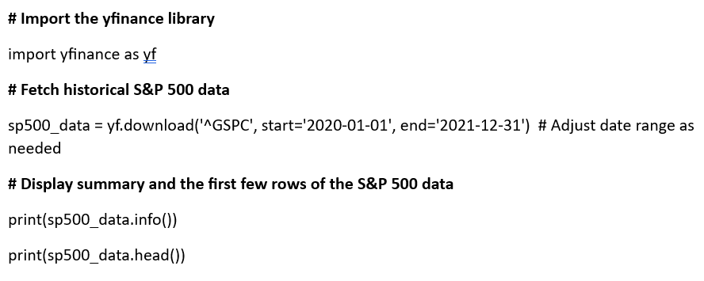
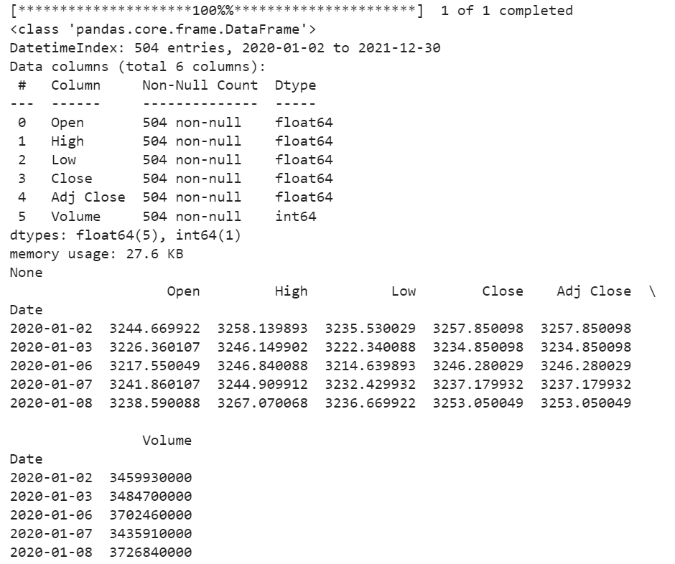
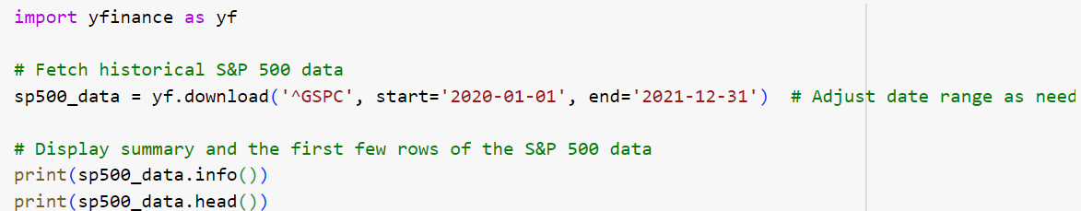
Feature Selection
Feature selection for S&P 500 data is taken as it helps in prediction as well as gives an idea about the core metrics that are essential for merged the data.
Pseudo Code:
Output:
Source Code:

Slide 14
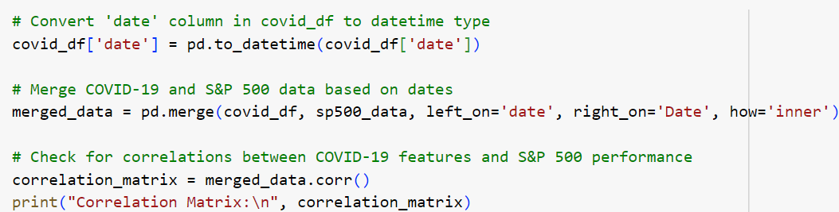
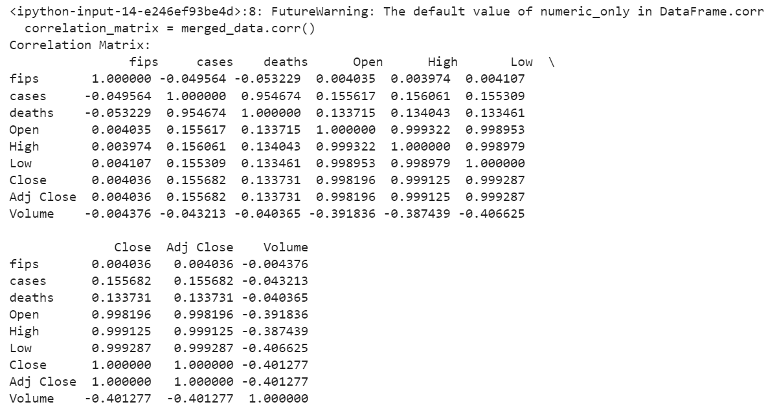
Merged Data
The merged dataset most likely combines financial market data—possibly even incorporating information on the S&P 500 stock index—with COVID-19 statistics. By combining several sources, it can establish a connection between COVID-19 measures (cases, fatalities) and financial indicators (stock prices) by utilizing shared identifiers such as dates or places. The goal of the dataset is probably to investigate any relationships or effects between financial markets and the pandemic.
Source Code:
Output:

Slide 15
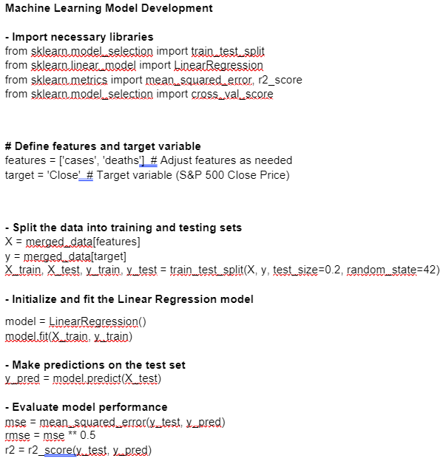
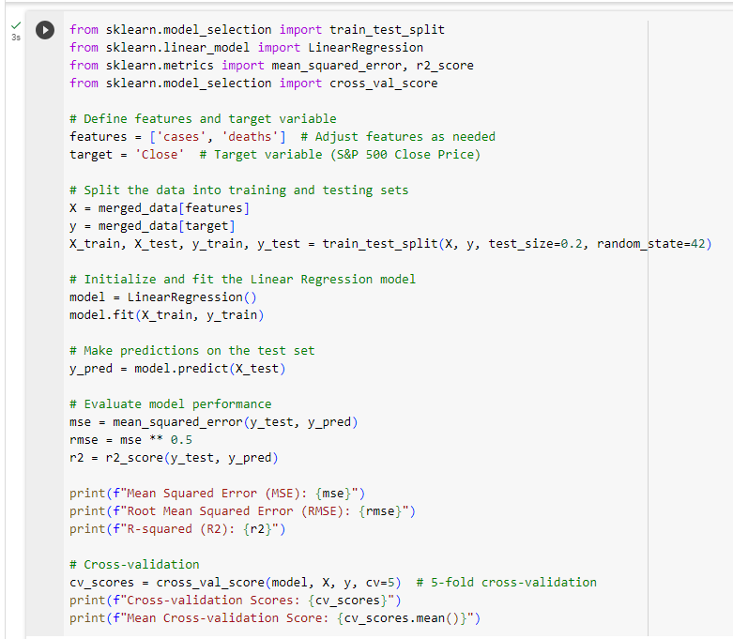
Machine Learning Model Developemnt
Machine learning model development includes defining the problem, collecting and preprocessing data, selecting features, choosing an algorithm, training and optimizing the model, and evaluating performance. Deployment is followed by continuous monitoring and maintenance for long-term effectiveness.
Here we imports the scikit-learn modules needed for model evaluation, training, and cross-validation. In order to define Variable and Features.
Training and Testing a data set is used for splitting the data, and thus we can build a linear regression model to do predictions on the test dataset.
Pseudo Code: Source code :

Slide 16
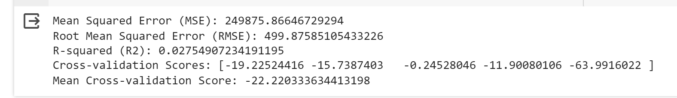
Machine Learning Model Developemnt | Score
Metrics like Mean Squared Error (MSE), Root Mean Squared Error (RMSE), and R-squared (R2) are used to know about our model performance. To obtain cross-validation scores and the mean cross-validation score for the model's overall performance evaluation, validation score is used in conjunction with a 5-fold cross-validation method.
Output:

Slide 17
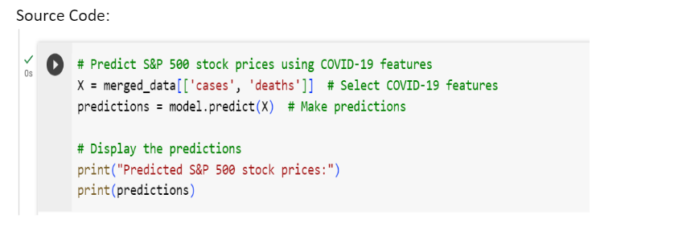
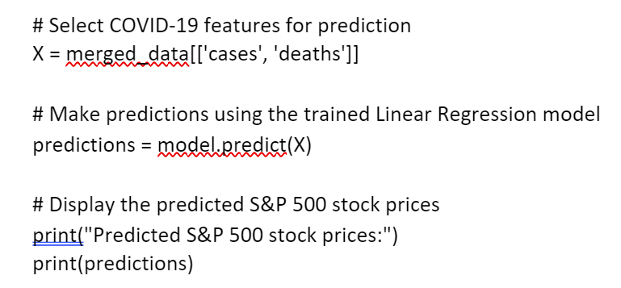
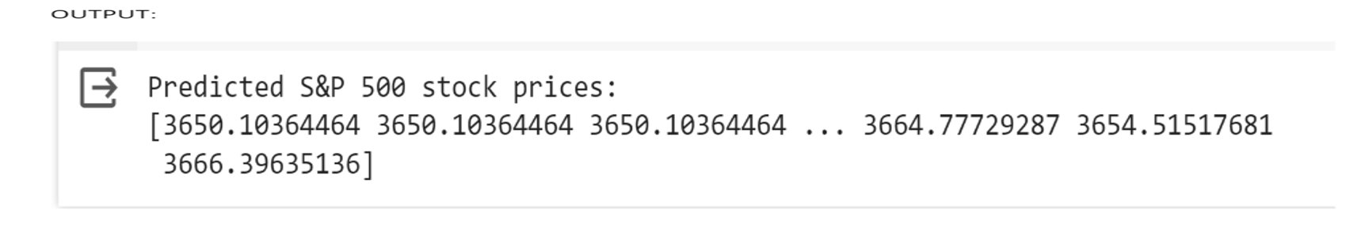
Predictions and Interpretation
Predictions involve forecasting outcomes using a trained model on new data. Interpretation is the process of understanding and explaining why the model made specific predictions, crucial for transparency and trust.
Model showed an effective predictive results, which helped for visualizing the data for better understanding.
Psoeudo Code:

Slide 18
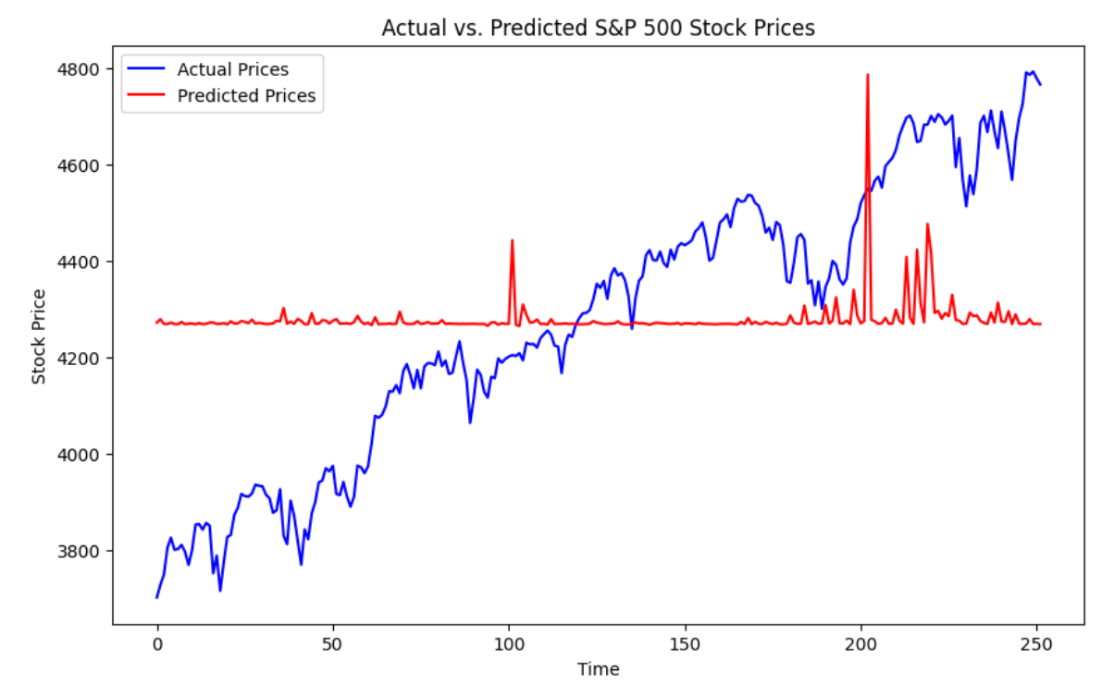
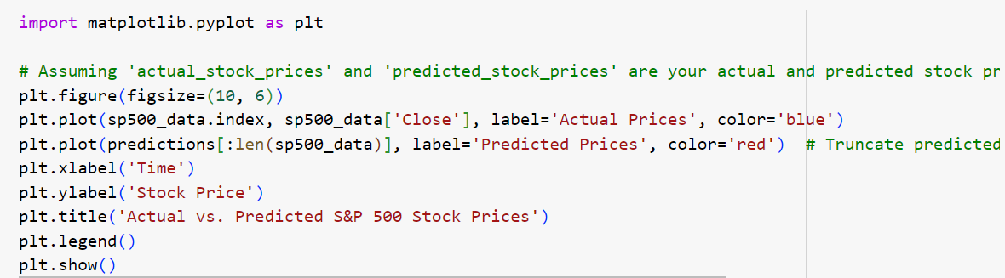
Visualization and Reporting
By utilizing the index of S&P 500 data as the x-axis, we've plotted the actual S&P 500 stock prices against the predicted prices. This visualization helps in comparing how well the predictions align with the actual stock prices over time.
Predicted vs Actual Stock Prices
Source Code:
Output:

Slide 19
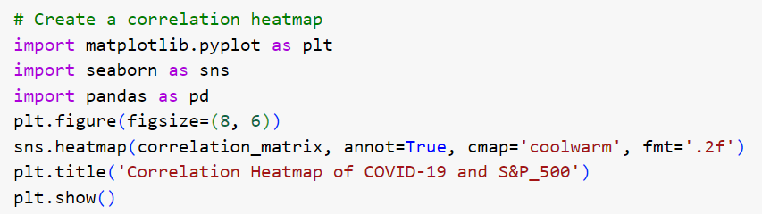
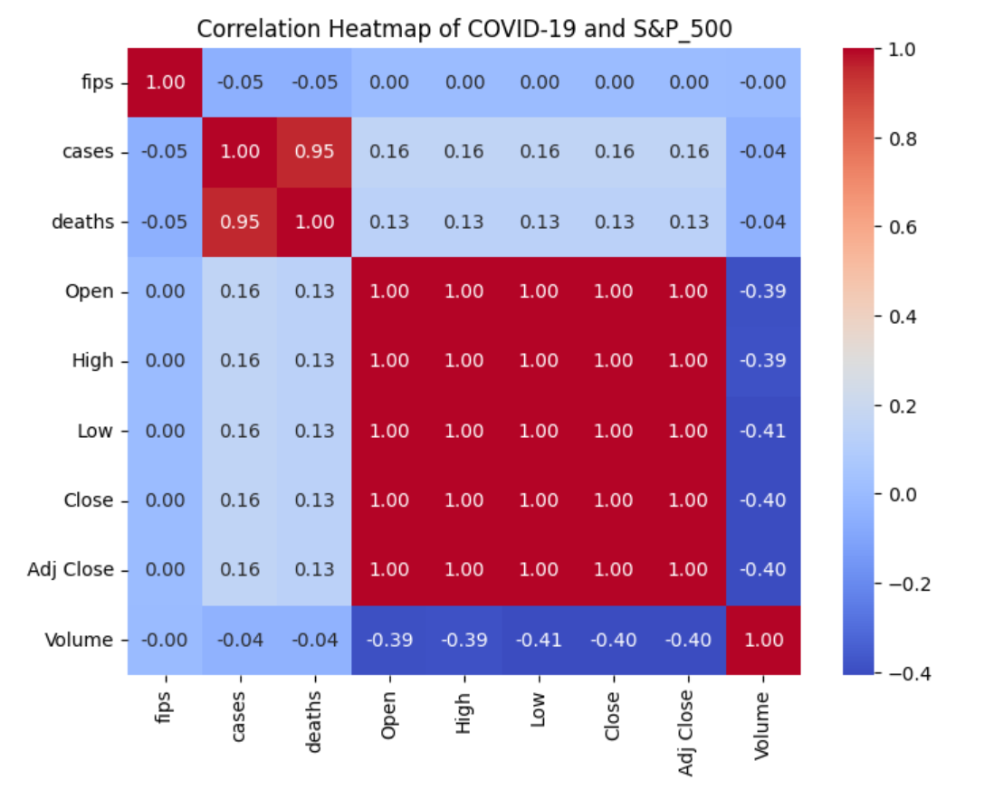
Visualization and Reporting
Heat Map:
Source Code:
Output:

Slide 20
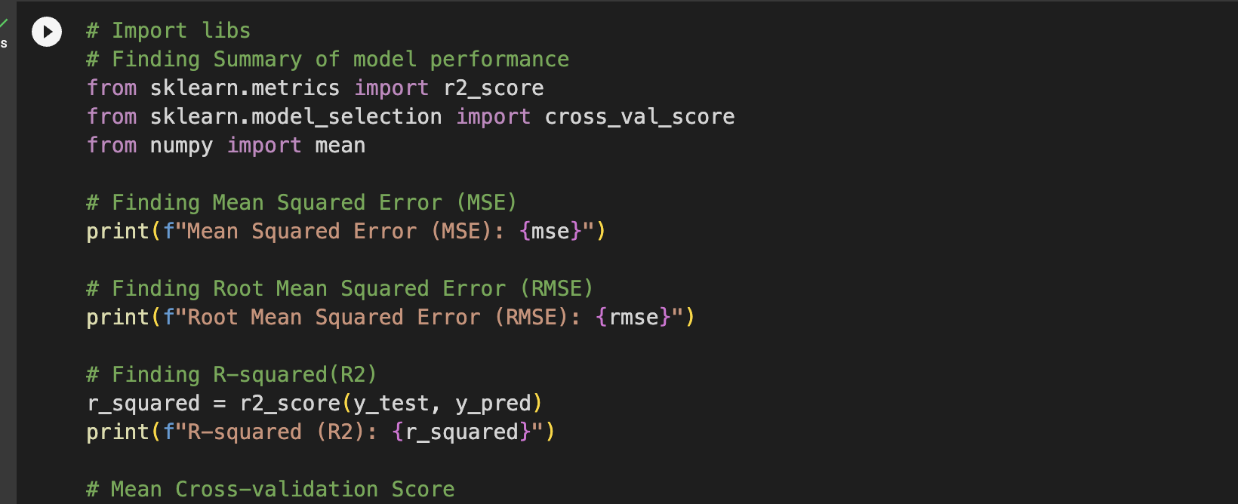
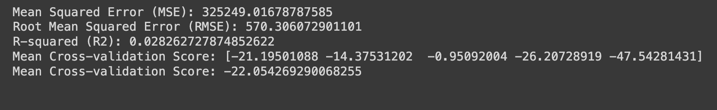
Model Performance (Predicted)
Overall, the model's high MSE and RMSE suggest considerable prediction errors, and the low R-squared shows an absence of predictive power. In addition, the model's low generalization capacity across different information subsets is shown by the negative mean cross-validation score, suggesting possible problems with its forecasting abilities.
Source Code:
Output:

Slide 21
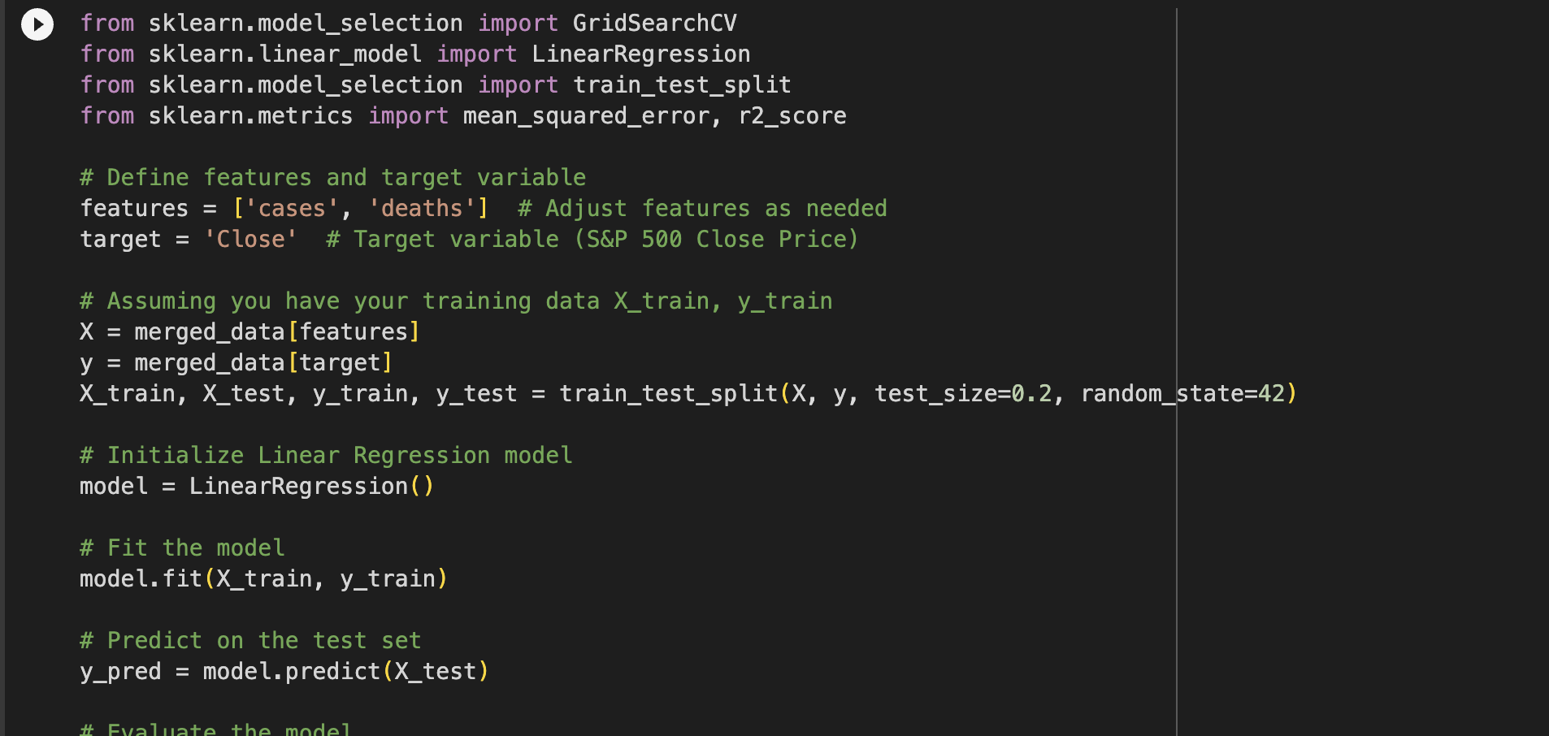
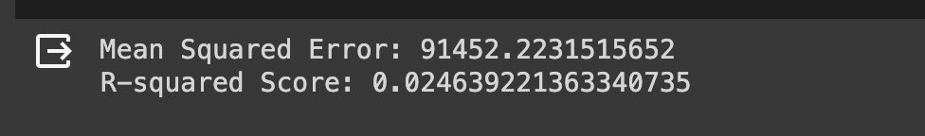
Iteration and Improvement
Based on COVID-19 features, we used Logistic Regression, which is intended for categorical issues with classification, to predict the daily S&P 500 Close Price. Regression with a classifier is tried and this results to the error.
Regression algorithms is suitable for continuous target variables should be employed in the model to deal with this.
The updated strategy identifies how the target variable is continuous and uses regression techniques like Linear Regression, Random Forest, or Gradient Boosting to reliably predict the S&P 500 Close Price.
Source Code:
Output:

Slide 22
Project Management | Status Report
Team Member | Tasks done | Contributions(%)
Yuvaraj Jami | Research related to the entire project coding review and cleaning the data and preprocessing data. Making the project flow and documentation work (Pseudo notes and Presentation). | 26
Durgasantosh Gaddam | Worked on Visualization and Reporting for Covid 19 and S&P data. | 24
Venkata Chennaiah Chavalam | Worked on Data Preprocessing and Exploratory data analysis and Model Development. | 25
Chilukuri Tagore Reddy | Worked on Feature Selection and Data merging of Covid and S&P 500 data. | 25
Concerns: Not knowing everything there was to know about the topic and not knowing what we wanted to achieve with our data were our concerns and challenges throughout the project. We were able to learn several concepts and apply them into practice with the professor's assistance after performing additional study and collaborating with fellow team members.

Slide 23
Project Links
Video Link
https://drive.google.com/file/d/1LpEEwroVzbh8pXIBYRlCNPuqt68DSQfB/view?usp=sharing
Drive Link
https://drive.google.com/drive/folders/1L9WKun7X6ojoGvx7F-5_RamziUVVAuhu?usp=sharing
Pseudo Code Document
https://drive.google.com/file/d/1rmgRmPpAcsmPpZiKxHpRQ85ee3-GsXEF/view?usp=sharing

Slide 24
References/ Bibliography
Li, W., Chien, F., Kamran, H. W., Aldeehani, T. M., Sadiq, M., Nguyen, V. C., & Taghizadeh-Hesary, F. (2021). The nexus between COVID-19 fear and stock market volatility. Economic Research-Ekonomska Istraživanja, 1–22. https://doi.org/10.1080/1331677x.2021.1914125
Phillips, M., & Bradsher, K. (2020, February 25). Stocks Slide for 2nd Day as U.S. Sounds Alarm on Coronavirus. The New York Times. https://www.nytimes.com/2020/02/25/business/stock-markets-covid-19.html
Basuony, M. A. K., Bouaddi, M., Ali, H., & EmadEldeen, R. (2021). The effect of COVID ‐19 pandemic on global stock markets: Return, volatility, and bad state probability dynamics. Journal of Public Affairs. https://doi.org/10.1002/pa.2761
Hesham, F., Riadh, H., & Sihem, N. K. (2021). What Have We Learned about the Effects of the COVID-19 Pandemic on Consumer Behavior? Sustainability, 13(8), 4304. https://doi.org/10.3390/su13084304
https://finance.yahoo.com/quote/%5Espx/

